Slide 1

Proposal Defense
Attention-Guided Deep Learning Architecture for Camouflaged Image Segmentation
Presented by : Nurfarhanah Amirah Binti Muhammad Nadzri
Supervised by : Dr Norashikin Binti Yahya
Internal Examiner : Ir Dr Ashvaany Egambaram
Course: RBB4032 Final Year Project I
Cluster: Intelligent Signal and Imaging
Date: 4th March 2026

Slide 2








OUTLINE OF PRESENTATION
Introduction
Problem Statement, Objectives, Scope of Study
Literature Review
Proposed Methodology
Gantt Chart & Milestones
Preliminary Results
Conclusion

Slide 3
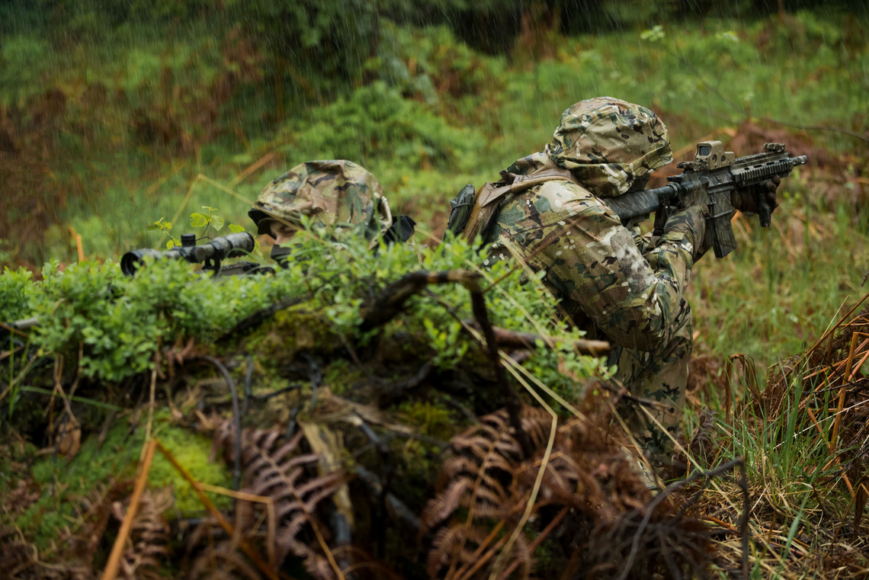
INTRODUCTION
Camouflaged object segmentation is challenging because objects blend with their surroundings.
Key challenges:
  Low foreground–background contrast
  Weak and ambiguous boundaries
  Texture similarity
  Background-dominant pixels
  Occlusion and complex shapes
Generic CNNs (e.g., U-Net) struggle due to lack of camouflage-aware modeling.
Camouflage-specific models like SINet improve localization and refinement, but boundary precision and background suppression remain challenging in complex military scenes.
Military camouflage

Slide 4




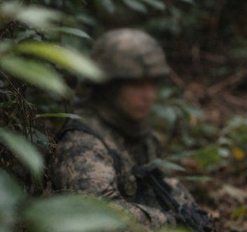
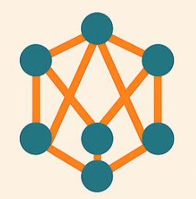
PROBLEM STATEMENT
Low foreground–background contrast and high texture similarity
Weak boundary representation and complex environmental blending
Existing models (e.g., U-Net and SINet) lack sufficient attention-based refinement

Slide 5



OBJECTIVES
To implement and evaluate baseline segmentation models (U-Net and SINet) for camouflaged image segmentation.
To develop an attention-guided enhancement integrated into SINet to improve feature discrimination and boundary precision.
To evaluate and compare baseline and proposed models using standard segmentation metrics (e.g., Dice coefficient and IoU).

Slide 6
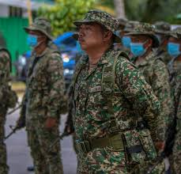
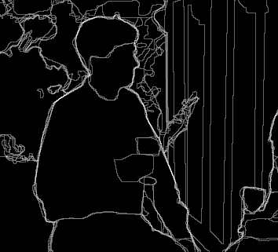
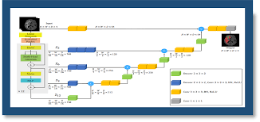
SCOPE OF STUDY
Focus on Malaysian military camouflage dataset for binary semantic segmentation (soldier vs background).
Implement baseline models (U-Net and SINet) for performance comparison.
Develop an attention-guided SINet-based model to improve boundary precision and feature discrimination, evaluated using Dice score

Slide 7
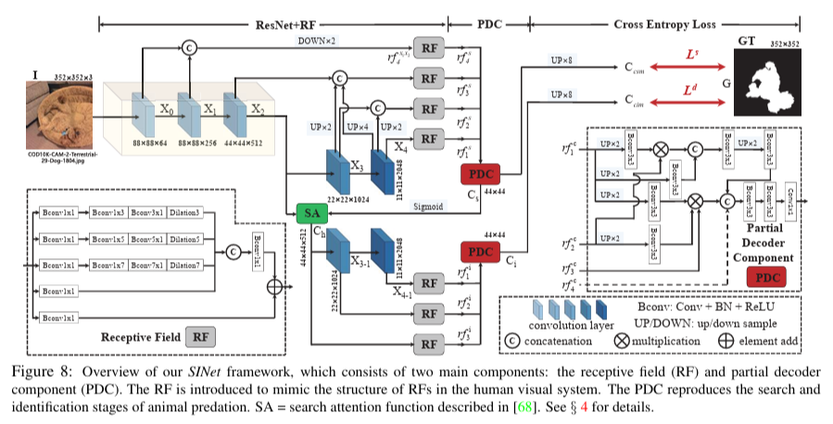
LITERATURE REVIEW
Semantic Segmentation Architectures for Camouflage
Model | Year | Core Architecture Idea | Camouflage-Specific Mechanism | Boundary Handling | Strength | Limitation | Ref
U-Net | 2015 | Encoder–decoder with skip connections | None (generic segmentation) | Implicit via decoder | Lightweight, works with small datasets | Struggles with low contrast & camouflage blending | [1]
SINet | 2020 | Two-stage Search → Identification pipeline | Search Attention (SA) to localize camouflage regions | Limited refinement | Strong first camouflage-specific baseline | Boundary precision still limited | [2]
SINet-V2 | 2022 | TEM + Neighbor Connection Decoder (NCD) + Group-Reversal Attention (GRA) | Cascaded refinement with hard-pixel weighted loss | Improved detail recovery via GRA | Most aligned with attention-guided refinement | Heavier than basic SINet | [3]
PFNet | 2021 | Positioning Module + Focus Module | Explicit distraction mining | Progressive ambiguous-region refinement | Strong foreground vs background separation | 416×416 input; heavier training setup | [4]
BGNet | 2022 | Edge-aware + Edge-guided feature integration | Explicit boundary supervision branch | Dice loss on edges + weighted mask loss | Strongest boundary-focused design | Additional edge branch increases complexity | [5]
ResNet + RF
  Extract image features
  Capture different scales
Search Attention
  Finds possible camouflage area
  Rough localization
Two-Stage Process
  First: Search
  Second: Refine
  Better than normal U-Net

Slide 8
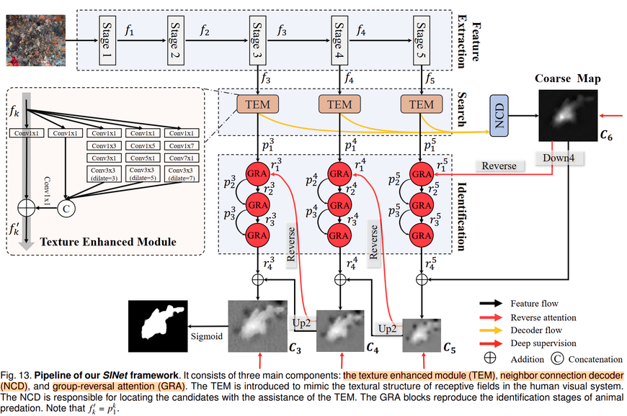
LITERATURE REVIEW
Semantic Segmentation Architectures for Camouflage
Texture Enhanced Module (TEM)
  Enhances texture features
  Improves camouflage discrimination
Neighbor Connection Decoder (NCD)
  Generates coarse localization map
  Connects high-level features efficiently
Group-Reversal Attention (GRA)
  Refines detected regions
  Focuses on hard and confusing areas
  Improves boundary precision
Three-Stage Strategy
  Feature Extraction
  Search (Coarse Map)
  Identification (Refinement)
Model | Year | Core Architecture Idea | Camouflage-Specific Mechanism | Boundary Handling | Strength | Limitation | Ref
U-Net | 2015 | Encoder–decoder with skip connections | None (generic segmentation) | Implicit via decoder | Lightweight, works with small datasets | Struggles with low contrast & camouflage blending | [1]
SINet | 2020 | Two-stage Search → Identification pipeline | Search Attention (SA) to localize camouflage regions | Limited refinement | Strong first camouflage-specific baseline | Boundary precision still limited | [2]
SINet-V2 | 2022 | TEM + Neighbor Connection Decoder (NCD) + Group-Reversal Attention (GRA) | Cascaded refinement with hard-pixel weighted loss | Improved detail recovery via GRA | Most aligned with attention-guided refinement | Heavier than basic SINet | [3]
PFNet | 2021 | Positioning Module + Focus Module | Explicit distraction mining | Progressive ambiguous-region refinement | Strong foreground vs background separation | 416×416 input; heavier training setup | [4]
BGNet | 2022 | Edge-aware + Edge-guided feature integration | Explicit boundary supervision branch | Dice loss on edges + weighted mask loss | Strongest boundary-focused design | Additional edge branch increases complexity | [5]

Slide 9
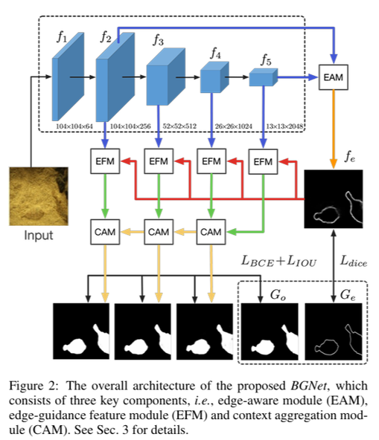
LITERATURE REVIEW
Semantic Segmentation Architectures for Camouflage
Model | Year | Core Architecture Idea | Camouflage-Specific Mechanism | Boundary Handling | Strength | Limitation | Ref
U-Net | 2015 | Encoder–decoder with skip connections | None (generic segmentation) | Implicit via decoder | Lightweight, works with small datasets | Struggles with low contrast & camouflage blending | [1]
SINet | 2020 | Two-stage Search → Identification pipeline | Search Attention (SA) to localize camouflage regions | Limited refinement | Strong first camouflage-specific baseline | Boundary precision still limited | [2]
SINet-V2 | 2022 | TEM + Neighbor Connection Decoder (NCD) + Group-Reversal Attention (GRA) | Cascaded refinement with hard-pixel weighted loss | Improved detail recovery via GRA | Most aligned with attention-guided refinement | Heavier than basic SINet | [3]
PFNet | 2021 | Positioning Module + Focus Module | Explicit distraction mining | Progressive ambiguous-region refinement | Strong foreground vs background separation | 416×416 input; heavier training setup | [4]
BGNet | 2022 | Edge-aware + Edge-guided feature integration | Explicit boundary supervision branch | Dice loss on edges + weighted mask loss | Strongest boundary-focused design | Additional edge branch increases complexity | [5]
Edge-Aware Module (EAM)
  Extracts boundary information
  Detects object edges
Edge-Guided Feature Module (EFM)
  Uses edge information
  Enhances segmentation features
Context Aggregation Module (CAM)
  Combines multi-scale features
  Improves region understanding
Boundary Supervision
  Uses Dice loss for edges
  Uses BCE + IoU for mask

Slide 10
LITERATURE REVIEW
Training Techniques for Camouflage Semantic Segmentation
Technique Name | Description | Purpose (Imbalance / Boundary / Generalization) | Typical Loss Functions | Data Augmentation Strategies | Computational Cost | Pros / Cons | Ref
Transfer Learning (Pretrained Backbone) | Uses ImageNet-pretrained backbone (e.g., ResNet-50) and fine-tunes on camouflage dataset. | Generalization | BCE, BCE+Dice | Random flip, resize, crop | Low–Medium | -Faster convergence and works with small dataset -May retain bias from natural images | [2]
Hybrid Loss (BCE + Dice / IoU) | Combines pixel-wise loss and overlap-based loss to improve segmentation quality. | Class imbalance | BCE + Dice / IoU | Standard augmentation | Low | -Handles background dominance and improves mask overlap -Requires loss balancing | [6]
Coarse-to-Fine Supervision (Multi-Stage Training) | Two-stage architecture: first coarse localization, then boundary refinement (e.g., SINet). | Boundary refinement | Multi-output BCE | Multi-scale training | Medium | -Better boundary precision and structured feature learning -Higher complexity | [2]
Attention-Based Feature Reweighting | Applies spatial/channel attention to suppress background and enhance foreground discrimination. | Background suppression + Boundary | BCE + attention-guided loss | Random crop, color jitter | Medium–High | -Focuses on confusing regions -Improves camouflage discrimination -Increased training cost | [7]
Semi-Supervised Learning (Pseudo-Labeling) | Uses labeled data to generate pseudo labels for unlabeled images to expand training set. | Generalization + Data scarcity | BCE + consistency loss | Strong–weak augmentation | Medium | -Utilizes unlabeled data and improves robustness -Risk of noisy pseudo-labels | [8]
Pretrained ResNet-50 backbone is used to provide strong initial feature representation, improving training stability, convergence speed, and generalization in complex camouflage environments.

Slide 11
LITERATURE REVIEW
Training Techniques for Camouflage Semantic Segmentation
Technique Name | Description | Purpose (Imbalance / Boundary / Generalization) | Typical Loss Functions | Data Augmentation Strategies | Computational Cost | Pros / Cons | Ref
Transfer Learning (Pretrained Backbone) | Uses ImageNet-pretrained backbone (e.g., ResNet-50) and fine-tunes on camouflage dataset. | Generalization | BCE, BCE+Dice | Random flip, resize, crop | Low–Medium | -Faster convergence and works with small dataset -May retain bias from natural images | [2]
Hybrid Loss (BCE + Dice / IoU) | Combines pixel-wise loss and overlap-based loss to improve segmentation quality. | Class imbalance | BCE + Dice / IoU | Standard augmentation | Low | -Handles background dominance and improves mask overlap -Requires loss balancing | [6]
Coarse-to-Fine Supervision (Multi-Stage Training) | Two-stage architecture: first coarse localization, then boundary refinement (e.g., SINet). | Boundary refinement | Multi-output BCE | Multi-scale training | Medium | -Better boundary precision and structured feature learning -Higher complexity | [2]
Attention-Based Feature Reweighting | Applies spatial/channel attention to suppress background and enhance foreground discrimination. | Background suppression + Boundary | BCE + attention-guided loss | Random crop, color jitter | Medium–High | -Focuses on confusing regions -Improves camouflage discrimination -Increased training cost | [7]
Semi-Supervised Learning (Pseudo-Labeling) | Uses labeled data to generate pseudo labels for unlabeled images to expand training set. | Generalization + Data scarcity | BCE + consistency loss | Strong–weak augmentation | Medium | -Utilizes unlabeled data and improves robustness -Risk of noisy pseudo-labels | [8]
Weak boundary representation remains a key challenge even in camouflage-specific models

Slide 12
LITERATURE REVIEW
Training Techniques for Camouflage Semantic Segmentation
Technique Name | Description | Purpose (Imbalance / Boundary / Generalization) | Typical Loss Functions | Data Augmentation Strategies | Computational Cost | Pros / Cons | Ref
Transfer Learning (Pretrained Backbone) | Uses ImageNet-pretrained backbone (e.g., ResNet-50) and fine-tunes on camouflage dataset. | Generalization | BCE, BCE+Dice | Random flip, resize, crop | Low–Medium | -Faster convergence and works with small dataset -May retain bias from natural images | [2]
Hybrid Loss (BCE + Dice / IoU) | Combines pixel-wise loss and overlap-based loss to improve segmentation quality. | Class imbalance | BCE + Dice / IoU | Standard augmentation | Low | -Handles background dominance and improves mask overlap -Requires loss balancing | [6]
Coarse-to-Fine Supervision (Multi-Stage Training) | Two-stage architecture: first coarse localization, then boundary refinement (e.g., SINet). | Boundary refinement | Multi-output BCE | Multi-scale training | Medium | -Better boundary precision and structured feature learning -Higher complexity | [2]
Attention-Based Feature Reweighting | Applies spatial/channel attention to suppress background and enhance foreground discrimination. | Background suppression + Boundary | BCE + attention-guided loss | Random crop, color jitter | Medium–High | -Focuses on confusing regions -Improves camouflage discrimination -Increased training cost | [7]
Semi-Supervised Learning (Pseudo-Labeling) | Uses labeled data to generate pseudo labels for unlabeled images to expand training set. | Generalization + Data scarcity | BCE + consistency loss | Strong–weak augmentation | Medium | -Utilizes unlabeled data and improves robustness -Risk of noisy pseudo-labels | [8]
Semi-supervised learning helps utilize unlabeled camouflage image (future direction)

Slide 13
LITERATURE REVIEW
Attention & Feature Reweighting
Why Important for Camouflage | Ref | Module | Type | What it Does
Suppresses background-dominant channels and enhances discriminative cues | [9] | SE (Squeeze-Excitation) | Channel Attention | Learns importance of each channel and rescales features
Low overfitting risk; suitable for small camouflage datasets | [10] | ECA (Efficient Channel Attention) | Lightweight Channel Attention | Simplified channel reweighting with minimal parameters
Improves boundary precision and reduces false positives | [2] | Sinet-V2 GRA | Reverse-Guided Refinement | Uses prediction map to guide iterative refinement
SE / ECA (Feature Recalibration)
  Reweights feature channels
  Suppresses background noise
  Lightweight and stable
SINet-V2 GRA (Refinement Attention)
  Reverse-guided refinement
  Multi-stage structure improvement
  Enhances boundary accuracy

Slide 14






LITERATURE REVIEW
• Generic segmentation models (e.g., U-Net) struggle with low contrast and camouflage blending.
• Camouflage-specific models (e.g., SINet, SINet-V2) improve localization but still face:
> Weak boundary precision
> Background-dominant feature activation
> Limited early feature recalibration
• Lightweight attention integration within camouflage pipelines remains under-explored.
This project proposes an Attention-Enhanced SINet Framework that:
• Integrates lightweight channel attention (SE / ECA) to suppress background-dominant features.
• Enhances refinement using camouflage-specific mechanisms (e.g., GRA-style refinement).
• Improves boundary precision and discrimination in complex military camouflage scenes.
• Maintains computational efficiency using pretrained ResNet-50 backbone.

Slide 15
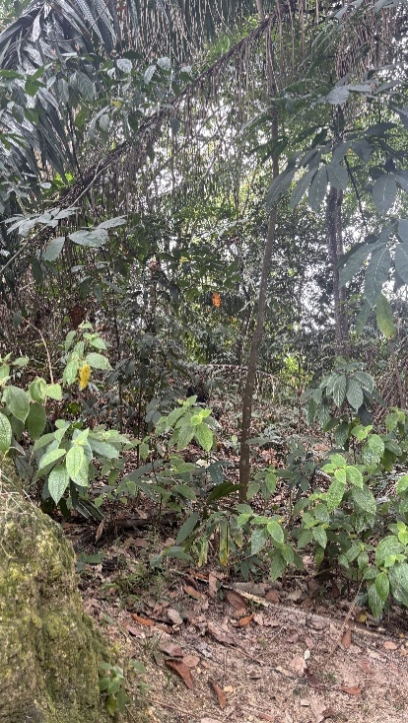
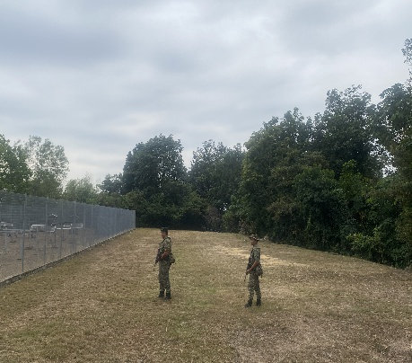
PROPOSED METHODOLOGY
Phase 1: Data Preparation
Phase 3: Proposed Attention-Enhanced SINet
Phase 5: Evaluation
• Total Dataset (STRIDE): 500
• Image resizing (256×256)
• Binary mask conversion
•Data augmentation (horizontal/vertical flip, rotation, brightness & contrast adjustment, resizing) is applied to improve generalization.
• Train / Validation / Test split
• Insert SE / ECA after RF feature extraction
• Integrate refinement mechanism (GRA-style)
• Fine-tune using transfer learning
• Dice Coefficient
• Intersection over Union (IoU)
• Visual qualitative comparison
💻 Software Environment:
• Python 3.x
• PyTorch
• OpenCV
• Matplotlib
• VS Code / Google Colab
🖥 Hardware
• NVIDIA MX350 GPU (2GB VRAM) (initial experiments)
• Optional higher-end GPU (Supervisor workstation / lab GPU)
• Windows OS
Phase 2: Baseline Model Implementation
Phase 4: Training Strategy
• Transfer learning (ImageNet pretrained weights)
• Hybrid loss (BCE + Dice / IoU)
• Batch size: 2–4
• 3–5 initial epochs (baseline validation)
• Early stopping
Baseline 1 – U-Net
• Encoder–decoder structure
• BCE / BCE + Dice loss
Baseline 2 – SINet
• Pretrained ResNet-50 backbone
• Search → Identification pipeline
Framework Used:
PyTorch (Deep Learning framework), Torchvision (Pretrained models)
The figure above shows sample datasets received from STRIDE.

Slide 16
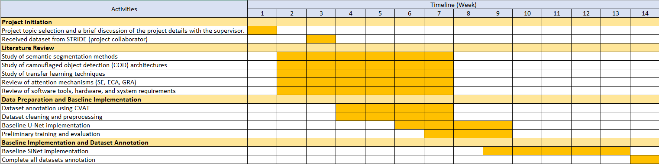
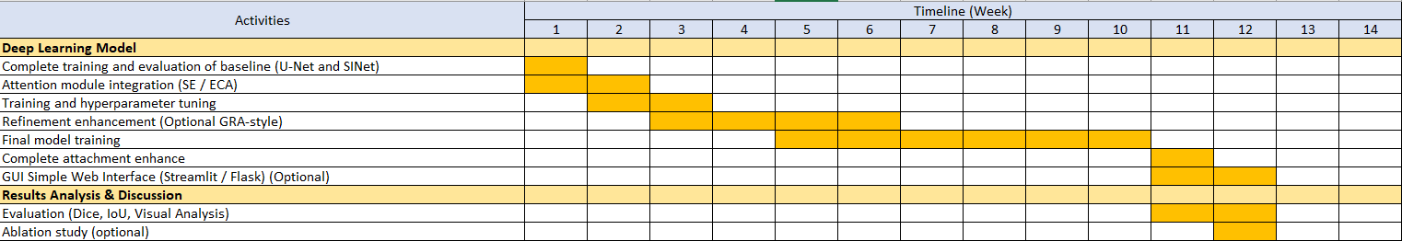
GANTT CHART & MILESTONES
FYP 1
FYP 2
Key Milestones

Slide 17
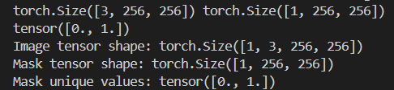

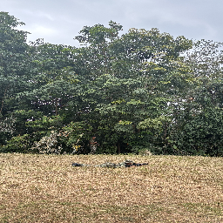
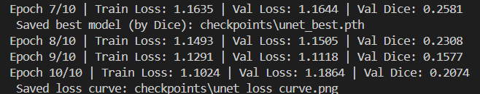
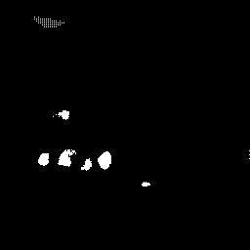
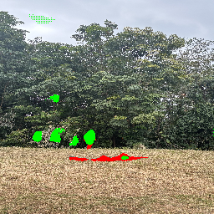
PRELIMINARY RESULTS
Data Validation
Ground Truth
Original Image
Training performance
  Manual annotation from CVAT
  White = soldier (foreground)
  Black = background
  Soldier blends with leaves
  Similar color (green/brown)
  Weak boundary between soldier and background
Baseline U-Net demonstrates learning capability but struggles with background suppression and boundary refinement in camouflage environments.
  • Model predicts multiple foreground regions
  • Significant false positive detected
  • Background regions misclassified as foreground
  • Soldier region partially detected in some cases
  Model detects some object-like regions
  High false positive rate
  Weak boundary precision
  Camouflage texture causes confusion
Prediction (Binary Mask)
Overlay (Red = Ground Truth, Green = Prediction)

Slide 18

CONCLUSIONS
In conclusion, research has demonstrated that generic segmentation models struggle in camouflage scenarios due to low contrast and poor boundary separation. Attention-guided and refinement-based architectures have been shown to significantly improve performance. Hence, this project proposes an attention-enhanced SINet-based framework to improve camouflaged object segmentation.

Slide 19
References
[1] O. Ronneberger, P. Fischer, and T. Brox,
“U-Net: Convolutional Networks for Biomedical Image Segmentation,” MICCAI, 2015.
https://arxiv.org/pdf/1505.04597
[2] D.-P. Fan, G.-P. Ji, G. Sun, M.-M. Cheng, J. Shen, and L. Shao,
“Camouflaged Object Detection (SINet),” Proc. IEEE/CVF Conf. Computer Vision and Pattern Recognition (CVPR), 2020.
https://openaccess.thecvf.com/content_CVPR_2020/papers/Fan_Camouflaged_Object_Detection_CVPR_2020_paper.pdf
[3] D.-P. Fan, G.-P. Ji, M.-M. Cheng, and L. Shao,
“Concealed Object Detection,” IEEE Transactions on Pattern Analysis and Machine Intelligence (TPAMI), 2022.
(SINet-V2)
https://ieeexplore.ieee.org/document/9395501
[4] H. Mei, G.-P. Ji, Z. Wei, X. Yang, X. Wei, and D.-P. Fan,
“Camouflaged Object Segmentation with Distraction Mining (PFNet),” Proc. IEEE/CVF Conf. Computer Vision and Pattern Recognition (CVPR), 2021.
https://openaccess.thecvf.com/content/CVPR2021/papers/Mei_Camouflaged_Object_Segmentation_With_Distraction_Mining_CVPR_2021_paper.pdf
[5] Y. Sun, S. Wang, C. Chen, and T.-Z. Xiang,
“Boundary-Guided Camouflaged Object Detection (BGNet),” Proc. International Joint Conference on Artificial Intelligence (IJCAI), 2022.
https://www.ijcai.org/proceedings/2022/0106.pdf

Slide 20
References
[6] Milletari et al., “V-Net: Dice Loss for Medical Image Segmentation,” 2016.
https://arxiv.org/pdf/1606.04797
[7] Sun et al., “C2F-Net: Coarse-to-Fine Network for Camouflaged Object Detection,” 2021
https://arxiv.org/abs/2104.02132.
[8] Liu et al., “Semi-Supervised Camouflaged Object Detection,” 2021.
https://arxiv.org/abs/2106.06741
[9] Hu et al., “Squeeze-and-Excitation Networks,” CVPR, 2018.
https://openaccess.thecvf.com/content_cvpr_2018/papers/Hu_Squeeze-and-Excitation_Networks_CVPR_2018_paper.pdf
[10] Wang et al., “ECA-Net: Efficient Channel Attention for Deep Convolutional Neural Networks,” CVPR, 2020.
https://openaccess.thecvf.com/content_CVPR_2020/papers/Wang_ECA-Net_Efficient_Channel_Attention_for_Deep_Convolutional_Neural_Networks_CVPR_2020_paper.pdf

Slide 21
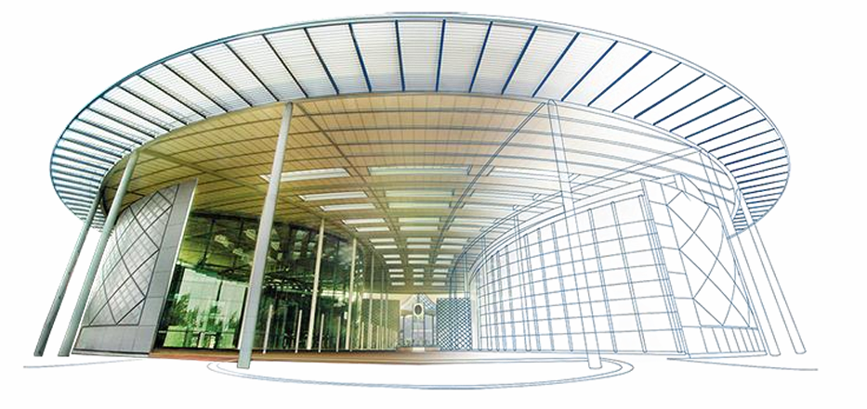
THANK YOU
Q & A

